Slide 1
Notes:
1

Slide 2
Agenda
Your Role / Applications
The policy
Claims made, Prior Acts and Tail Coverage
Who is Insured and What is Covered
Professional Liability claims – when to report
Selecting a Carrier/Policy/Broker
Risk Management /Engagement Letter
Cyber Liability Exposures For Law Firms
Cyber Liability Insurance

Slide 3
Professional Liability Exposures and Insurance

Slide 4
Your Role
Administrators play a crucial and unique role in a law firm.
Keep in mind an underwriter does not know your firm. They are evaluating the risk by what is on the application only. You need to brag about yourself and the firm
You can affect premium by letting the underwriters know things that may not be ask on the application
Is their additional training in the firm
Is there a mentoring program for new lawyers
What are your internal systems, are the fail safe

Slide 5
The Application Process
There are credits and debits applied to all firms. Some of these are discretionary for the underwriter and can help you save money.
The application is the first impression. Your broker should be reviewing the application and having discussions with you.
The effect of slight changes in AOP- carefully review each year, it matters!
Adding an addendum regarding risk management practices of the firm. Let the underwriter know how great the firm is.
If you are reporting a claim, make sure you include what steps have been taken to avoid it, even its meritless.

Slide 6
The Application Process examples
Our firm will not take any Personal Injury case within 6 months of the statue of limitations .
Our firm has a statute of limitations system that does not allow any billing until the statue has been put into system. System is monitored weekly.
Any case that is within the 6 month period and has been filed goes to the managing partner
All new cases are reviewed and accepted or declined by management team
Firm has a mentoring program where each new lawyer is assigned to a specific partner
The firm reviews and discusses all open cased on an annual basis. Mandatory

Slide 7
Claims Made vs. Occurrence Policy
An LPL policy generally provides coverage for demands made upon the policyholder for damages brought forth during the policy period resulting from an error or omission within the firms covered prior acts date.
You must haven coverage in place when the error occurs as well as when the claim is filed. The policy in place at the time the claim is filed is the policy that will cover the claim.
An “occurrence” policy (such as a homeowner’s policy) normally insures an unexpected event within the policy period that result in bodily injury or property damage.

Slide 8
Prior Acts Coverage
“Retroactive Date”
The date continuous coverage was first obtained
Claims triggered before this date are not covered
Changing Carriers
Lapse In Coverage (options)

Slide 9
Extended Reporting Periods
“ERP or Tail Coverage”
Available for attorneys or firms who dissolve their practice
Know the cost and options (225% vs. 300%) (6 year vs. Unlimited)
Provides coverage for claims arising from conduct within the policy period which would otherwise be covered by the policy, but the claim is first made during the extended reporting period.
Claim must have occurred while policy was in force.
NPERP, Free or Costly
Available for Attorneys retiring from the practice of law

Slide 10
What is Covered & Who is Covered?
Professional Services
Title Agent
Activities as an Officer or Director
Author or Presenter
Supplementary Coverages (will discuss in detail)
Insured
Named Insured
Employees
Former Partners, Officers, Associates, Employees
Of Counsels
Independent Contractors

Slide 11
Common & Uncommon Exclusions
Intentional Acts
Dishonesty
Fraudulent or Criminal Acts
Bodily Injury / Property Damage
Fee Suit Exclusion
Punitive Damages
Insured vs. Insured
Unless Attorney Client relationship exists, and professional services are being rendered.
Owned Equity
Normally greater than 10%-15%

Slide 12
Important Coverage Options
Deductible Options (Per Claim vs. Aggregate vs. Loss Only)
Defense Costs(Inside Limits vs. Outside Limits)
Definition of Professional Services & Definition of Insured (the broader the better)
Exclusions (uncommon, Fee Suits, Punitive Damages, Equity Interest)
Supplementary Coverages (Professional Liability Policies are so much more than limits and deductible)

Slide 13
Important Policy Features
Policy Features
Consent to settle Provision (Hammer Clause)
Choice of Counsel
Extending Reporting Period Options
Limited Exclusions
Special Features (Deductible Reductions, Risk Management Discounts)
Supplementary Coverages
Disciplinary Proceedings
Subpoena
Loss of Earnings
Network Risk Coverage
1st Party
3rd Party

Slide 14
Experience
AM Best Rating/Security
Claims Handling/Panel Counsel
Panel Counsel
Risk Management Services (what does your carrier do for you besides send you a bill every year?)
Website
Claims Hotline
CLE
Newsletter & Email Alerts

Slide 15
What to consider when selecting a broker
Experience with Lawyers
Benchmarking
Claims knowledge
Advocacy
Specialists (very specific type of insurance)
Endorsements
Can they leverage their relationships to help provide specific coverage options for your firm?
Options
Customer Service (how many people at the office know your firm and how many people fully understand your practice)
Full Service

Slide 16
Risk Management
Engagement Letters
Non-Engagement
Dis-Engagement
Fee Suits
Attend Risk Management Seminars specific to your areas of Practice
Try not to Dabble in areas out of your comfort zone
Buy Broad Professional Liability Insurance and use it
Client Selection

Slide 17
Cyber Exposures For Law Firms

Slide 18
Rich Collection of Data
Sensitive Information
Bank Information
PII
Poor Safeguards
Lack of internal training and controls
Lack of IT resources
Wireless access
Vendor Management
Lost of stolen devices
Internal Exposures
Rogue employees
Careless staff
External Exposures
Business associates, vendors and suppliers
Organized crime
Hackers

Slide 19
Small and midsize businesses (SMBs) are the principal target of cybercrime.
Based on one study, 60 percent of all targeted cyberattacks last year struck SMBs.
SMBs are easier targets than larger organizations.
Many SMBs lack sufficient resources and in-house expertise to address cyberattacks.
It has been estimated that half of the small businesses that suffer a cyberattack go out of business within six months as a result.
Source: U.S. Securities and Exchange Commission, “The Need for Greater Focus on the Cybersecurity Challenges Facing Small and Midsize Businesses,” 2015.

Slide 20
Cyber Exposure and the Need for Insurance

Slide 21
Cyber Exposures – Cyber Loss
Regulatory actions and scrutiny
Loss or damage to reputation
Cyber-extortion
Cyber-terrorism
Management time expended on breach response

Slide 22
Cyber Exposures – How a Law Firm can Protect itself
Buy Cyber Coverage!
Incident Response Planning
Employee Training
Risk Analysis
Encryption
MFA

Slide 23
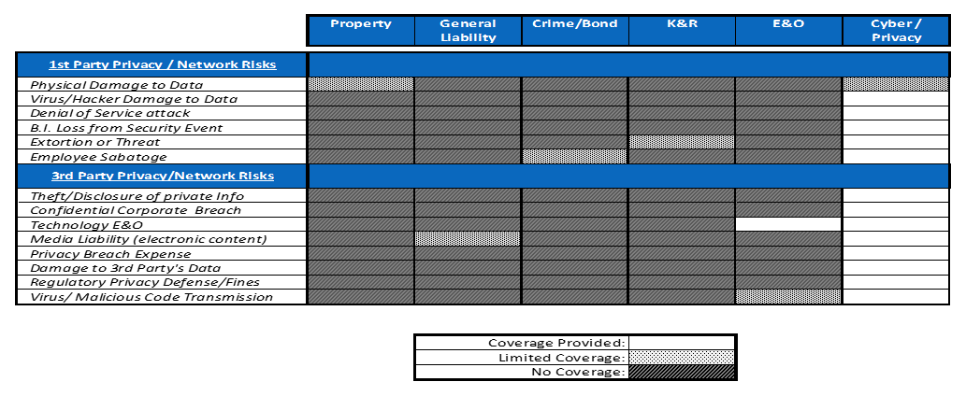
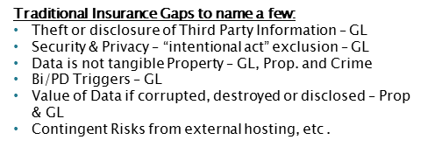
Insurance Coverage Gaps

Slide 24
Claim Statistics
Source: NetDiligence 2017 Cyber Claims Study

Slide 25
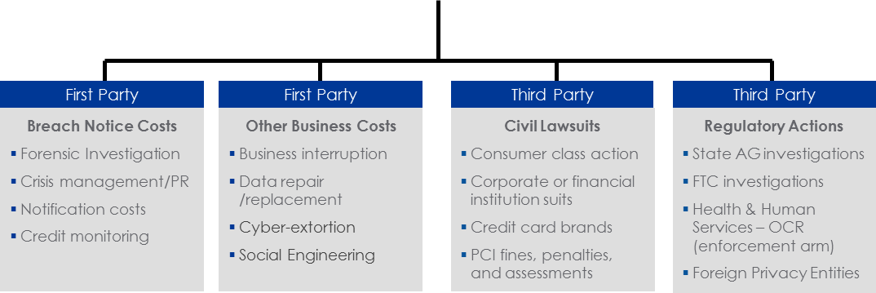
What Does Cyber Insurance Cover?
Cyber Liability

Slide 26
Contact Information
Email address: mark.lefever@usi.com
shelly.lawson@usi.com

